Slide 1
NETFLIX DATASET
Reinforcement Project-Tableau
Prabin P
DA&DS

Slide 2
Project Overview
The aim of this Tableau project is to explore and visualize trends in Netflix content using a dataset that includes information such as titles, genres, release years, countries, and content types . The data was uploaded from a CSV file and cleaned within Tableau.
An interactive dashboard was designed to help users quickly understand Netflix’s global content distribution, genre popularity, and changes in content type over time. Visuals include bar charts, pie charts, line graphs, and filters for user-driven exploration.
This project demonstrates the ability to prepare data, build calculated fields, use advanced Tableau features, and present data-driven insights through compelling visual storytelling.

Slide 3
Dataset Overview :
Topic : Netflix Dataset
Number Of Records : 6234 Attributes Included :
Show ID
Type
Tittle
Director
Cast
Country
Date
Release Year
Rating
Duration
Listed In
Description

Slide 4
Dashboard Overview :
Line Graph : Total Movies & TV Shows by Year
Map Chart : Total Movies & TV Shows by Country
Bar Chart : Top 10 Genre
Bar Chart : Movies &TV Shows Rating
Bubbles Chart : Total Movies & TV Sales
Filter :
Year
Rating
Genre
Description
Duration

Slide 5
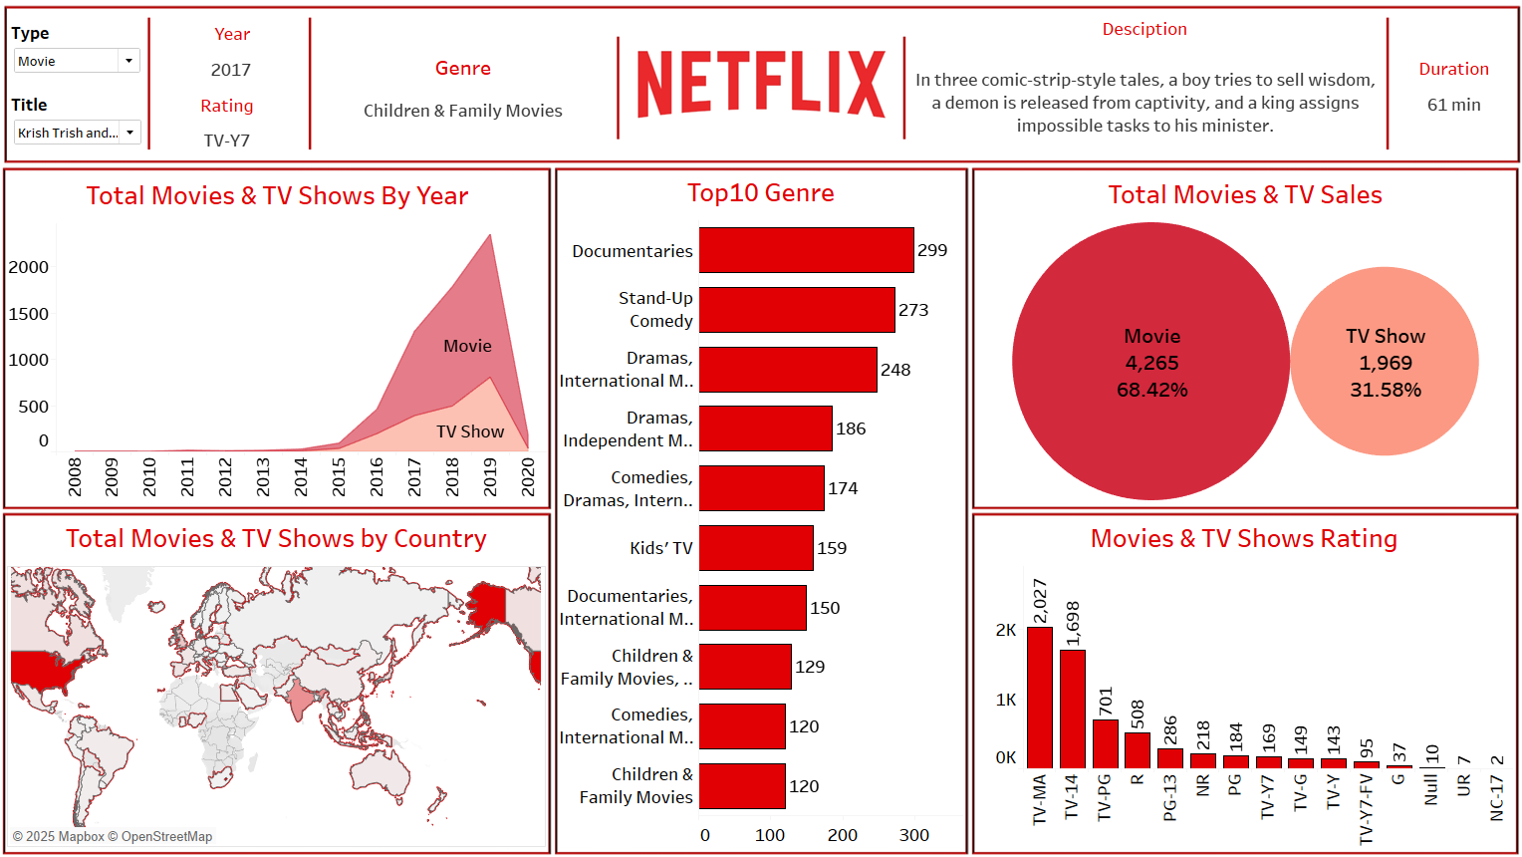
Dashboard

Slide 6
Conclusion :
Tableau facilitated a detailed and interactive exploration of Netflix content data.
The dashboard revealed patterns in content type, genre popularity, and regional distribution.
Key insights support content strategy, user engagement, and localization decisions.
This project highlights the power of data visualization in understanding entertainment industry trends.

Slide 7
THANK YOU

